Slide 1
Build MVC apps with the Microsoft Graph .NET SDK
Build a ASP.NET web application using Microsoft Graph

Slide 2

Register Azure AD Applications
Registering Applications in the Azure Portal
Configure credentials
Select the type of application
Configure permissions

Slide 3

Endpoint versions
v1
Microsoft account
Azure Active Directory v2.0 endpoint
Converged authentication accepts sign in from both Microsoft personal accounts and Azure AD work and school accounts.
Enables the same code for using Microsoft Graph for things like reading mail or retrieving contacts.
Dynamic consent, requesting permissions when you need them.
Additional Microsoft Graph capabilities for AAD users such as SharePoint and Microsoft Teams.
Azure Active Directory v1 endpoint
Enables access to Azure protected resources
v2
v1
Azure Active Directory
http://aka.ms/aadv2
AD
AD
AD
Notes:
The v2 endpoint includes breaking changes to protocols.
This is why it is the V2 endpoint. Because the protocol is different, requires new client library implementations.

Slide 4
Key improvements v2.0 versus v1
scope instead of resource parameter for interop
v1: resource=https://graph.microsoft.com
v2: scope=https://graph.microsoft.com/User.Read or scope=User.Read
Dynamic instead of static consent for incremental consent
id_token claims updated to OpenID Connect standard
Single app registration to represent native and web application combination
Well-known OpenID scopes
offline_access – Enables retrieving refresh tokens
openid – Allows your app to sign the user in and receive an app-specific identifier for the user
email – Allows your app access to the user’s primary email address via the email claim in the token
profile – Allows your app access to all other basic information such as name, preferred username, object ID, and others.
https://docs.microsoft.com/en-us/azure/active-directory/develop/azure-ad-endpoint-comparison
Notes:
In v1 endpoint, had to provide resource parameter to identify which resource you were requesting an access token for. Open source libraries were not able to easily incorporate into requests. Now use the scope parameter, which is supported by all libraries, to compound the resource and permission.
When you build applications with AADv1, had to register what permissions the application needed, and user consented to all permissions statically. With AADv2, can now send scopes you want at the time you want them, don’t need to ask for all of it up front.
Changed contents of id_token to better conform to Open ID Connect 1.0 specification, such as using preferredUserName claim instead of UPN claim. The most
In the past, if you needed a client app, single page app, web app, and web API, you had to create multiple registrations and wire up the relationships between them. AAD v2 now enables one registration across a single logical application.
For more information: https://docs.microsoft.com/en-us/azure/active-directory/develop/active-directory-v2-compare

Slide 5
Registering an Azure AD application in the Azure Portal

Slide 6
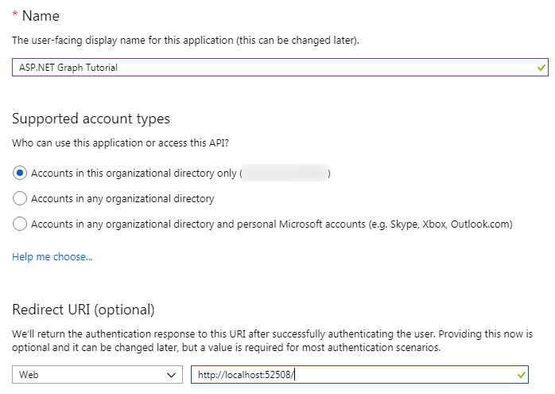
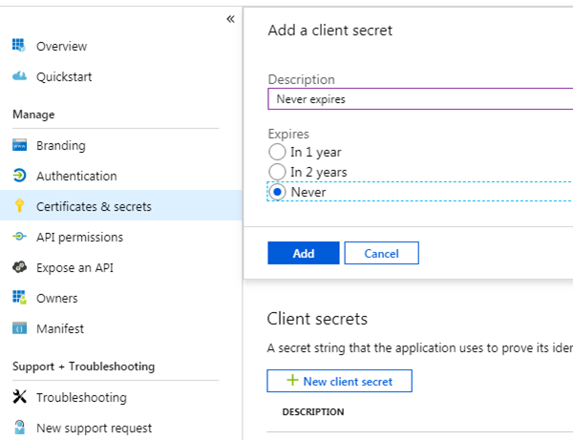
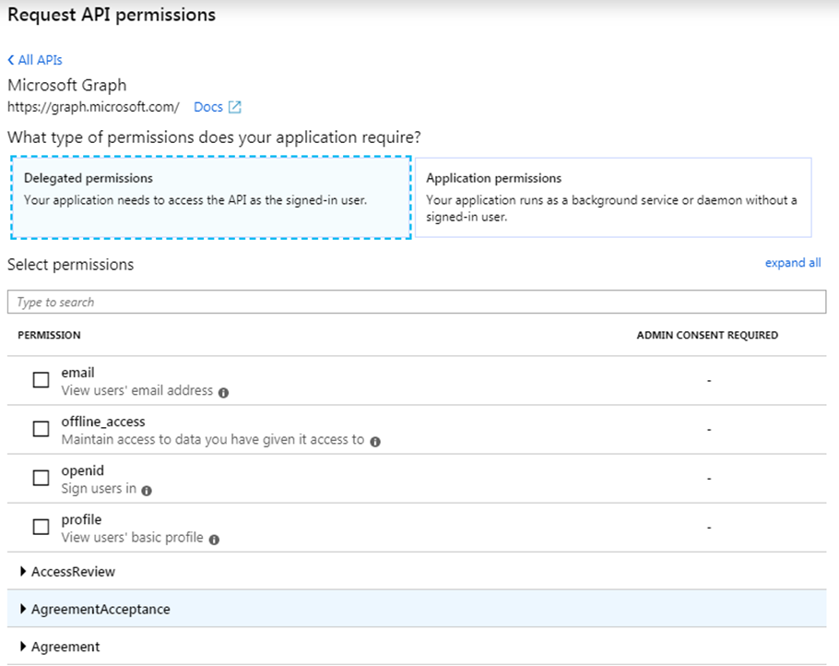
Application registration
Create a new application
Create a new application in the Application Registration Portal. A unique identifier is created for your app.
Create a client secret
Add a “password” for your application
Add permissions
Add permissions that your application will need if your admin will consent for all users.

Slide 7
Demo

Slide 8
Thank you.

